Slide 1
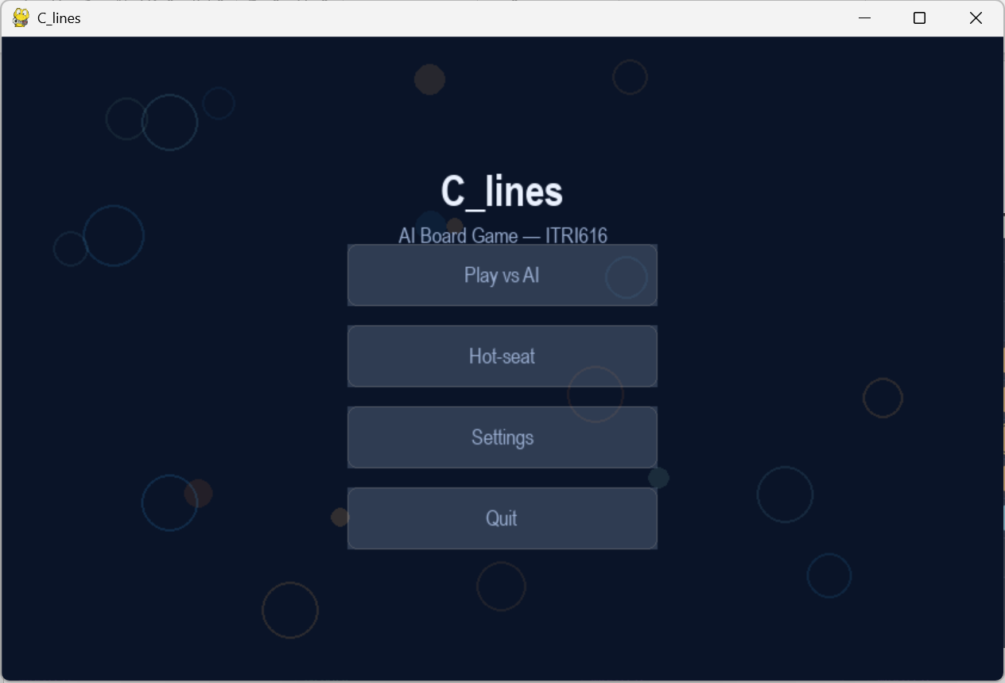

C_lines
A self-play reinforcement-learning agent for an original board game
ITRI 616 Artificial Intelligence 1 · 8×8 board · points-until-full · run_pts_002 (10,000 self-play games)
Notes:
[Slide 1 | ~22s | running 0:22]
Note: full read is about 6 minutes. Sentences marked [OPTIONAL] can be cut to come in under 5 minutes. Good day . For AI project I built a C_Line game. This is a 2 player game that you can play against a friend or against the AI agent that I trained to play. In this presentation I am going to explain the game rules, how I built agent, defining the problem, algothm and results. Hi. This project is C_lines, an original two-player board game I designed, and an agent that learns to play it well entirely by playing against itself. In the next few minutes I'll cover three things: the problem, the algorithm, and the evidence that the agent improves with experience.
Hi. This project is C_lines, an original two-player board game I designed, and an agent that learns to play it well entirely by playing against itself. On screen is the game I built; you can play against the trained agent or in hot-seat mode. In the next few minutes I'll cover the problem, the algorithm, the evidence that it improves with experience, and a short critical analysis.

Slide 2
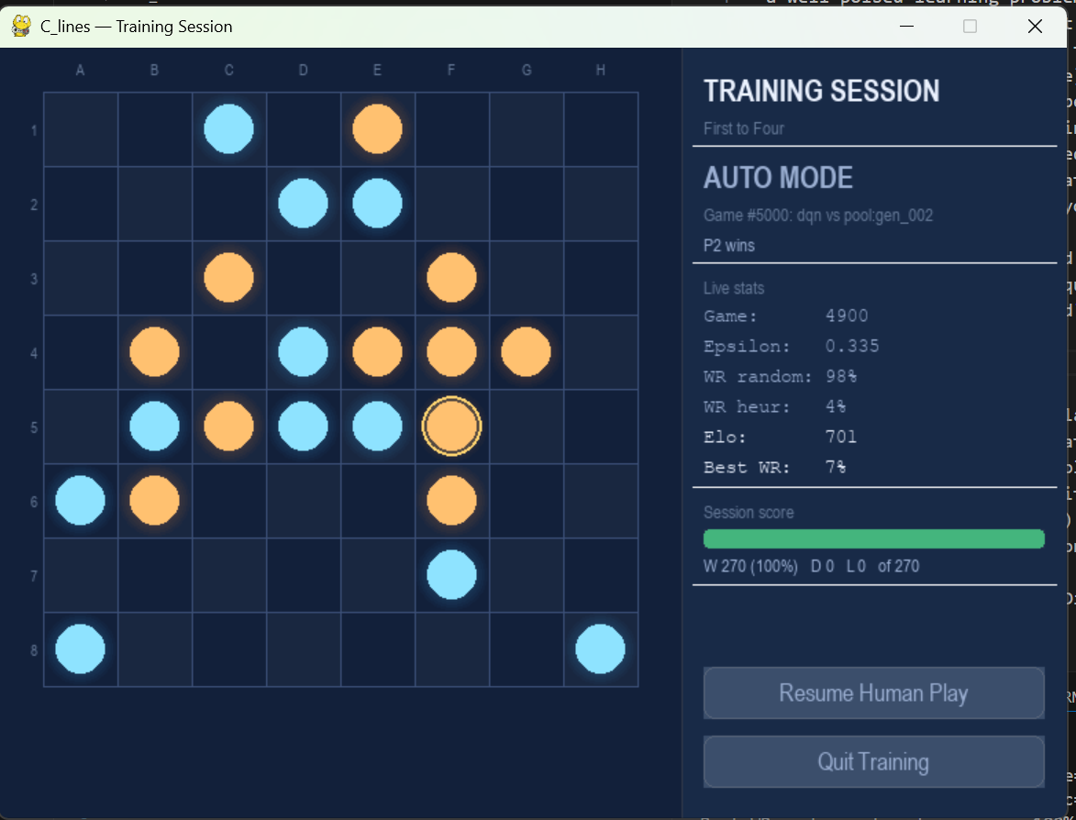
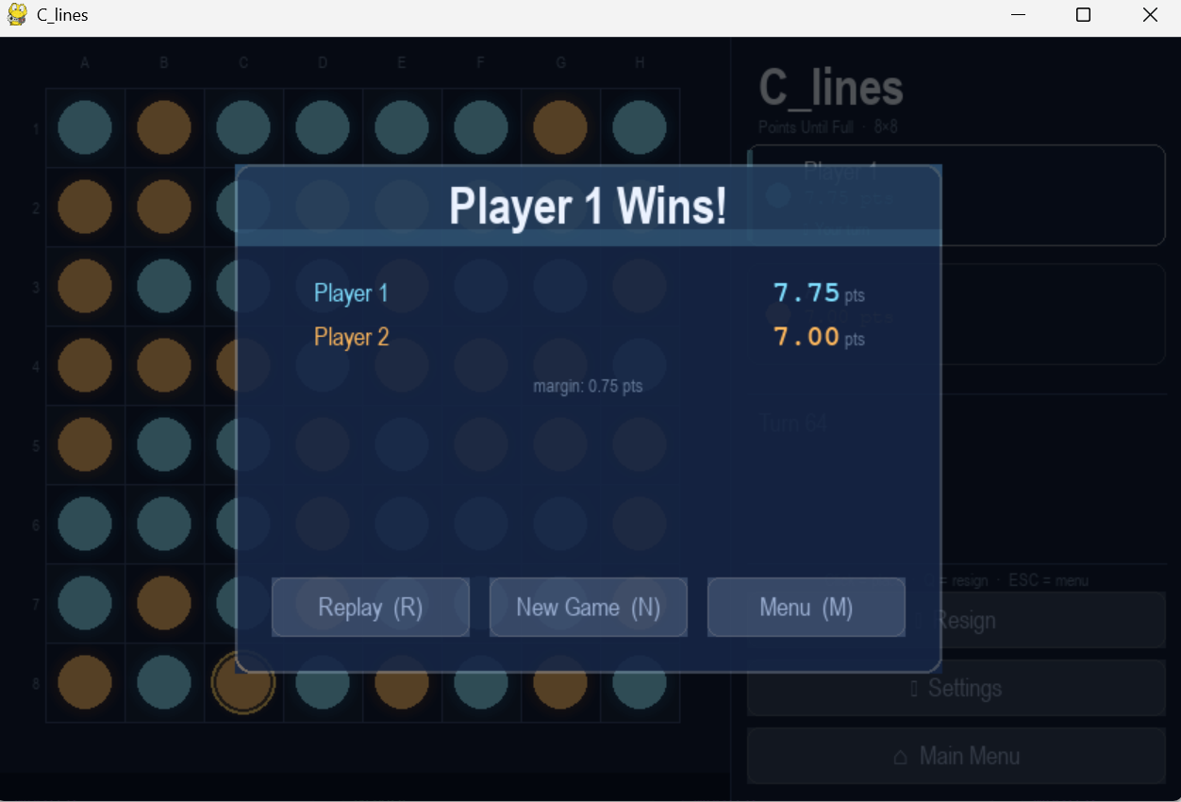
The game: C_lines on an 8×8 board
PROBLEM DEFINITION
• Open placement, players alternate, placing one stone on ANY empty cell; no gravity, no column rule.
• Board fills, play continues until all 64 cells are occupied.
• Line scoring , score for straight runs (any direction) of length 3–8; longer lines worth far more (3 → 0.25 … 8 → 5.0).
• Win condition, highest total score when the board fills; a tie-break removes draws.
• There are possible 64 opening moves
You must BUILD your own lines and BLOCK the opponent over a 64-move horizon.
Notes:
[Slide 2 | ~48s | running 1:10]
C_lines is played on an eight-by-eight board. Players take turns placing one stone on any empty cell; there's no gravity and no column rule, you can play anywhere. Play continues until the board is full, sixty-four stones. You score for straight lines of your own stones in any direction, and longer lines are worth disproportionately more, a line of three is a quarter point, scaling up to five points for a line of eight. Highest total score when the board fills wins. On the right are two screenshots from the actual game: the top is a training session running, and the bottom is a finished game, where Player 1 won seven point seven five to seven, which is how a points game is decided.

Slide 3
The learning problem
PROBLEM DEFINITION & TEP FRAMEWORK
T
Task
E
Experience
P
Performance
Choose the placement that maximises the final score margin (own − opponent). Category: sequential DECISION-MAKING / CONTROL
Self-generated games: a short warm-up vs Random & Heuristic, then SELF-PLAY against frozen past versions. As the agent improves, so do its opponents
Four metrics every 100 games: win rate vs Random, vs Heuristic, an Elo rating, and win rate vs a 4-ply Alpha-Beta search.
Notes:
[Slide 3 | ~62s | running 2:12] I built the agent to win the to have game to win the game with as large point differential as possible. In this fully observable environment where in each turn of the agent’s turns it can see the board state, where the pieces are and the current points table. Its task is to choose the move that maximises the final score margin between the agent and its opponent. The experience comes from gameplay. Playing against random and heuristic opponents to develop basic skills, and later spends most of its time playing against itself and previously saved versions of itself. . performance is measured using four independent metrics: win rate against a random opponent, win rate against a heuristic opponent, an Elo rating, and performance against an Alpha-Beta search player.
I framed this with Mitchell's Task, Experience, and Performance structure.
The Task: given a board, choose the placement that maximises my final score margin, my score minus my opponent's. In category terms it's sequential decision-making and control, not classification and not prediction, because the agent has to act and its actions decide the outcome.
The Experience is the heart of the design. The agent learns from four kinds of opponent, each for a different reason. Against a random opponent it sees a wide variety of positions, which builds basic competence and stops it overfitting to one style. Against the rule-based heuristic, which takes a winning four-in-a-row if it can, otherwise blocks the opponent's, otherwise just extends its own longest line, it is forced to learn real blocking and line-building. It also plays copies of itself at its current strength, which gives balanced, sharp games, and it plays frozen snapshots of its earlier selves from a growing pool, so it never forgets how to beat older strategies and always has an opponent near its own level, a curriculum that rises automatically. [OPTIONAL: The random and heuristic games dominate early to seed good habits; self-play and snapshots take over later to keep pushing the ceiling.]
Performance is tracked four ways, every hundred games: win rate against random, against the heuristic, an Elo rating, and win rate against a four-ply alpha-beta search.

Slide 4
The algorithm: a self-play Deep Q-Network
TECHNICAL UNDERSTANDING & METHODOLOGY
10-channel board state
Residual CNN (4 blocks, 64ch)
Q-value per cell
ε-greedy move
→
→
→
Learning loop: transitions are stored in a replay buffer and feed gradient updates.
Why DQN?
• Sequential control with delayed reward, a move's value only emerges when the board fills.
• Q-learning's TD target is built for that credit assignment.
• No labelled 'correct' moves exist for an original game, so supervised learning does not apply.
Reward design
• Dense delta-score shaping: per-move change in (own − opponent) score.
• Plus a terminal ±1 for the win / loss.
• Every step points to the same goal as the final outcome.
Notes:
[Slide 4 | ~46s | running 2:58]
The algorithm is a Deep Q-Network, which is value-based reinforcement learning. It is a neural network estimates the value of each possible move, and the agent plays the highest-valued legal cell. The board goes in as a ten-channel image: its stones, the opponent's stones, empty cells, and tactical layers such as where my open three-in-a-rows are. The network is a residual convolutional neural network. I chose because it is well suited to spotting line patterns. I chose a Deep Q-Network because this is sequential control with delayed reward, a move's true value only emerges when the board fills, and because there are no labelled correct moves supervised learning doesn't apply.

Slide 5
Three implementation choices that make it work
TECHNICAL UNDERSTANDING & METHODOLOGY
Negamax value target
The next position is the OPPONENT's, so the bootstrap is subtracted, not added: target = r − γ·max Q(s′).
Double DQN + Huber loss
The online net selects the action, the target net evaluates it, cutting overestimation. Huber loss keeps updates stable against large TD errors. Together: no late-run collapse.
D4 symmetry augmentation
Every board is also 7 rotations / reflections, multiplying training data eight-fold for free and regularising toward the board's true symmetry.
Plus: target-network sync, gradient clipping, plateau LR decay, and snapshotting every 1,000 games into 10 playable difficulty levels.
Notes:
[Slide 5 | ~37s | running 3:35]
One, getting the sign right. The agent rates a move by picturing the board straight after it plays. But that next turn belongs to my opponent, so the board is being judged from their side, and a position that is great for them is bad for me. So the agent has to subtract that value, not add it. It sounds tiny, but if you add it the agent chases moves that help its opponent. In a two-player game like C_lines this is the most important thing to get right.
Two, keeping the learning steady. This kind of agent tends to over-trust its own best guesses, and that can make it grow strong and then suddenly fall apart late in training. I fix this two ways: one copy of the network chooses the move and a separate copy scores it, so it checks its own optimism; and I measure its mistakes in a way that ignores the occasional wild outlier. Together these stop it from collapsing.
Three, free practice from symmetry. A C_lines board plays exactly the same if you rotate or mirror it — the strategy doesn't change. So every game I play can be turned into eight versions, and the agent gets eight times the practice from the same number of games. [OPTIONAL: And every thousand games I freeze a copy of the agent and register it as a playable difficulty level.]
Three choices made it work. First, the negamax value target: because the next position belongs to my opponent, its value is subtracted, not added. That is the single most important correctness detail in two-player value learning. Second, Double Deep Q-Network updates and a Huber loss keep the value estimates stable and prevent the late-training collapse that plain Deep Q-Networks suffer. Third, I exploit the board's eight-fold symmetry, every position is also seven rotations and reflections, which multiplies the training data for free. [OPTIONAL: And every thousand games I freeze a snapshot and register it as a playable difficulty level.]

Slide 6
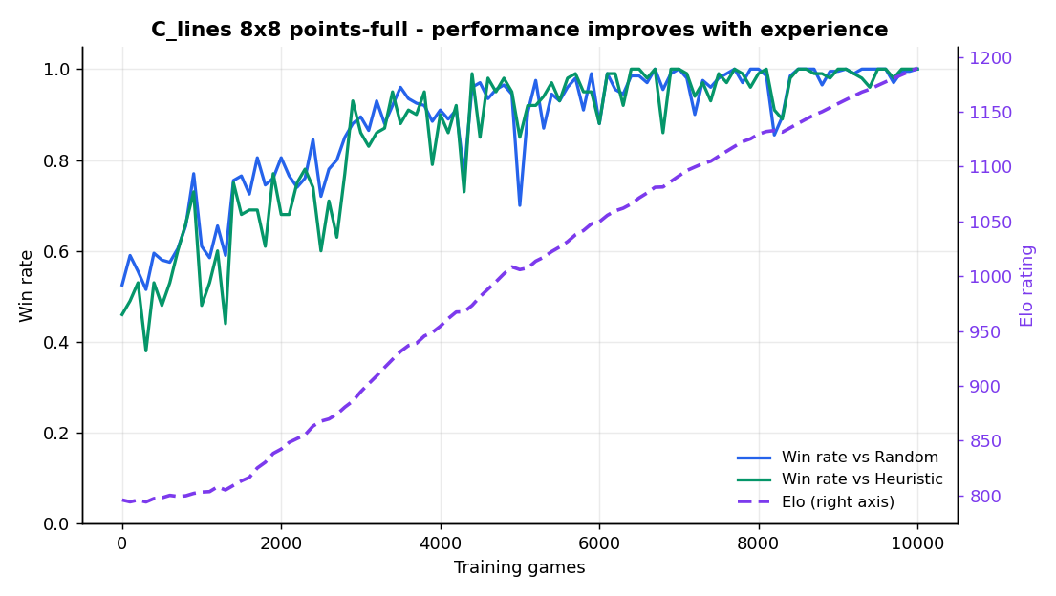
Result: performance improves with experience
RESULTS PRESENTATION & ANALYSIS
796 → 1190
Elo (monotone, +394)
52.5% → 100%
Win rate vs Random
46% → 100%
Win rate vs Heuristic
Notes:
[Slide 6 | ~57s | running 4:32]
This slide shows the overall learning trajectory across ten thousand self-play games.
The simplest metrics are the win rates against the random and heuristic opponents. Both increase steadily from roughly fifty percent at the beginning of training to one hundred percent by the end.
Once win rates reach one hundred percent, they can no longer distinguish between a good agent and an even better one. For that reason, the most informative metric is the Elo rating shown by the purple curve.
Elo measures relative playing strength by comparing performance against fixed reference opponents. Because those opponents never improve, any increase in Elo reflects a genuine improvement in the agent itself.
Across training, the agent's Elo rises from 796 to 1190 without any significant collapse, providing strong evidence that performance improves with experience.
But beating familiar opponents is not enough. To demonstrate real learning, the agent must also succeed against opponents it never encountered during training.
Here's the core result, one run of ten thousand games. Win rate against random and against the heuristic both climb from about half to a hundred percent. The headline is the Elo rating, the purple curve, so let me explain how that is assigned, since it's the main metric. Elo is the rating idea from chess: you gain points for beating a higher-rated opponent and lose points for losing to a lower-rated one. I gave the reference opponents fixed ratings, random at six hundred, the heuristic at nine hundred, and the alpha-beta search at twelve hundred, and I started the agent at eight hundred. Every hundred games the agent plays twenty games against each fixed-rating opponent, and its rating is nudged up or down by the standard Elo formula based on how it scored. Because those reference opponents never improve, the agent's rating rises only when it genuinely beats them by more, here monotonically from 796 to 1190, with no collapse. [OPTIONAL: It also keeps measuring progress after the raw win rates have maxed out at a hundred percent.]

Slide 7
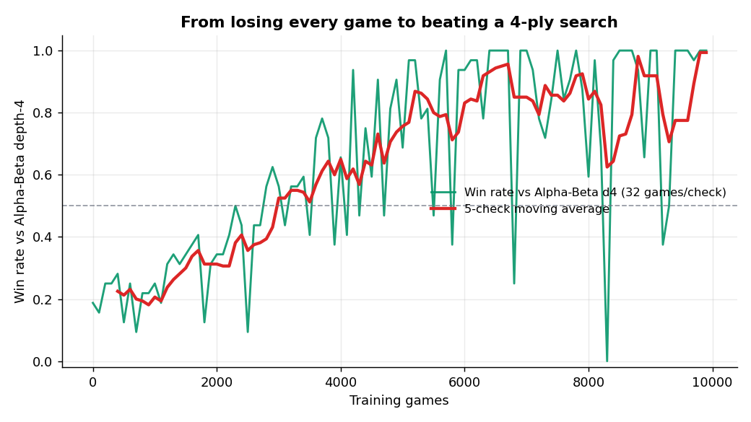
The decisive test: beating a 4-ply search
RESULTS PRESENTATION & ANALYSIS
vs Alpha-Beta depth-4
an opponent the agent NEVER trains against
19% → 100%
win rate
−0.83 → +1.17
mean score margin (sign flips)
Winning by a margin against an independent search = genuine generalisation, not memorisation.
Notes:
[Slide 7 | ~30s | running 5:02]
The agent was tested against a depth-four Alpha-Beta search player, a classical search algorithm that it never faced during training.
Early in training, the agent struggled. It won only about nineteen percent of games and typically lost by a measurable score margin.
By the end of training, the picture had completely changed. The win rate approached one hundred percent, and the average score margin became positive.
This result matters because it demonstrates generalisation rather than memorisation. The agent was not simply learning how to defeat a fixed training opponent. Instead, it acquired strategies that transferred successfully to an independent search-based player.
The strongest evidence is against the alpha-beta search, a classical look-ahead search to depth four that the agent never trains against. Early on it wins about nineteen percent and loses on score, by an average margin of minus zero point eight three. By the end it wins essentially a hundred percent, and the score margin flips to plus one point one seven. Winning by a margin against an independent search it cannot have memorised, the move tree is far too large, means the agent genuinely generalised.

Slide 8
Critical analysis
CRITICAL THINKING
Model
Residual CNN matches local line patterns; tactical channels free the network to weigh threats, not relearn rules.
Method
Negamax target keeps the value function coherent; Double-DQN + Huber explain the stable, collapse-free convergence.
Results
Win rates saturate at 100% - Elo keeps resolving improvement; the per-snapshot noise is why Elo is the headline.
Improve
Multi-seed bands, n-step returns, an AlphaZero-style policy + MCTS head, and a deeper benchmark.
Notes:
[Slide 8 | ~38s | running 5:40]
The residual convolutional architecture is well matched to the game's spatial structure. It can recognise local patterns and tactical opportunities efficiently.
Using multiple performance measures provides a more complete picture than relying on win rate alone. Once win rates saturated, Elo continued to reveal meaningful improvements.
There are also opportunities for future work. Running multiple training seeds would provide stronger statistical confidence,. A critical look, in four parts. The model: the residual network matches local line patterns, and the tactical input channels free it to weigh threats rather than relearn the rules. The method: the negamax target keeps the value function coherent, and the stability choices explain the smooth, collapse-free convergence. The results: the win rates saturate at a hundred percent, which is why I lean on the Elo rating, and the noise between individual checkpoints is why a single curve is more trustworthy than any one point. [OPTIONAL: To improve, I would repeat the run across several random seeds for confidence bands, use multi-step returns, and add a Monte-Carlo Tree Search policy head in the style of AlphaZero.]

Slide 9
A self-play DQN learned an original board game, from a blank slate to out-playing a 4-ply search
1,190
final Elo
100%
vs Random, Heuristic & AB-d4
10,000
self-play games
The performance improves with experience. Every result is reproducible from the logged data with one command.
python -m src.training.train --games 10000 --size 8 --benchmark alphabeta_d4
Thank you
Notes:
[Slide 9 | ~22s | running 6:02]
this project demonstrates that a self-play Deep Q-Network can learn a completely original board game from scratch.
Starting with no knowledge of strategy, the agent improved through experience alone, achieving an Elo rating of 1190, consistently defeating all fixed benchmark opponents, and ultimately outperforming a depth-four Alpha-Beta search player that it never encountered during training.
Taken together, these results provide clear evidence that performance improved with experience, which is the central objective of machine learning.
Thank you for watching.

